Slide 1
John 19.31-42
1944-45 Phillies Logo image from sportslogos.net

Slide 2
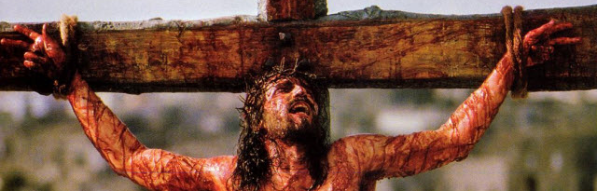
John 19.31-32 NET: Then, because it was the day of preparation, so that the bodies should not stay on the crosses on the Sabbath (for that Sabbath was an especially important one), the Jewish leaders asked Pilate to have the victims' legs broken and the bodies taken down. So the soldiers came and broke the legs of the two men who had been crucified with Jesus, first the one and then the other.
Bible-History.com

Slide 3
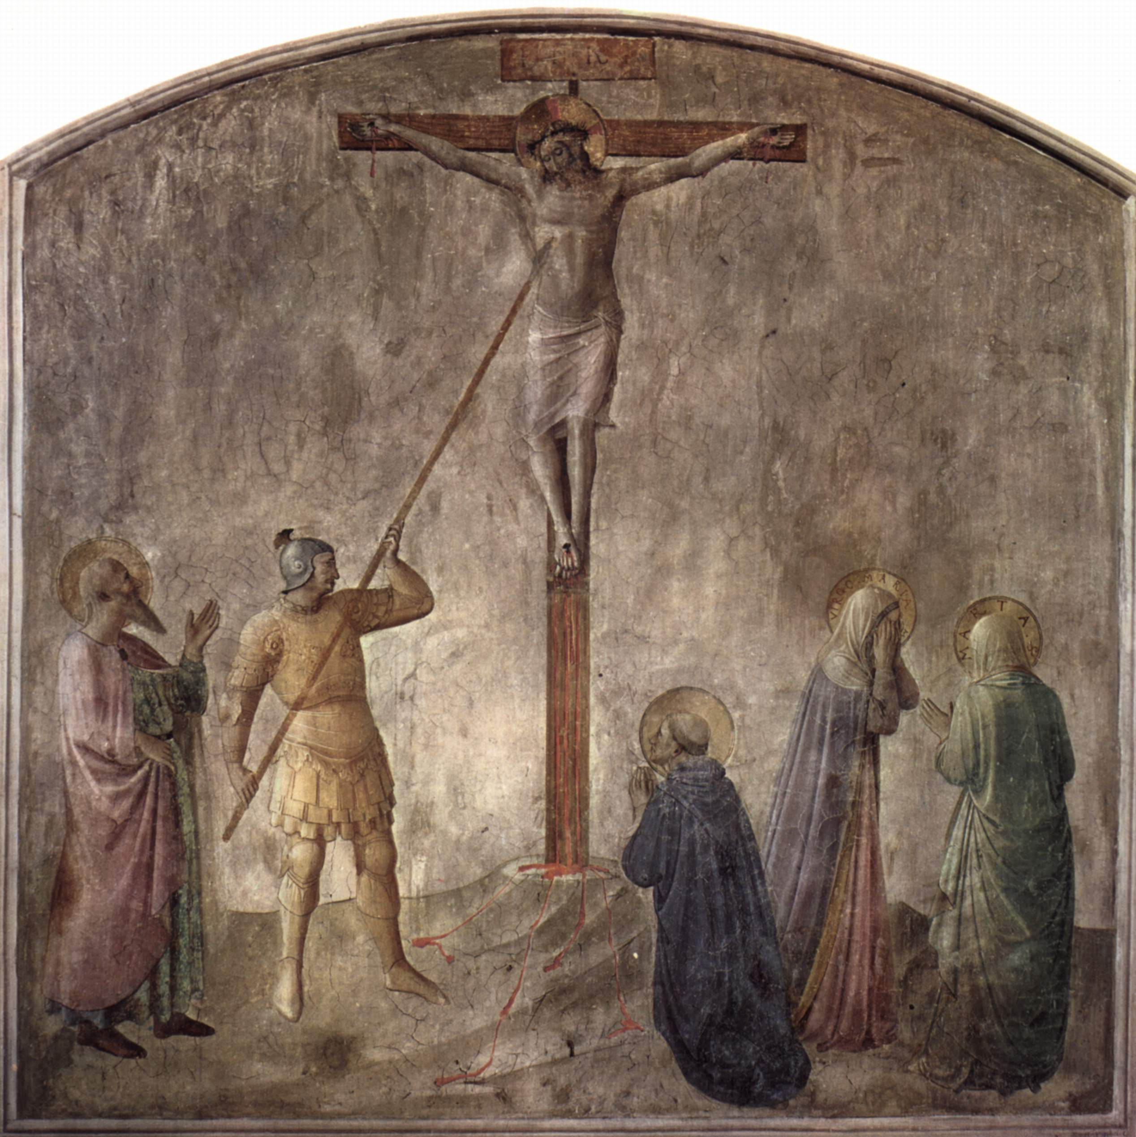
John 19.33-34: But when they came to Jesus and saw that he was already dead, they did not break his legs. But one of the soldiers pierced his side with a spear, and blood and water flowed out immediately.
Fresco by Fra Angelico, Dominican monastery at
San Marco, Florence, Italy; photo from Wikipedia.org

Slide 4
John 19.35-37: And the person who saw it has testified (and his testimony is true, and he knows that he is telling the truth), so that you also may believe. For these things happened so that the scripture would be fulfilled, “Not a bone of his will be broken.” And again another scripture says, “They will look on the one whom they have pierced.”
Exodus 12.43-47

Slide 5
John 19.35-37: And the person who saw it has testified (and his testimony is true, and he knows that he is telling the truth), so that you also may believe. For these things happened so that the scripture would be fulfilled, “Not a bone of his will be broken.” And again another scripture says, “They will look on the one whom they have pierced.”
Zechariah 12.10

Slide 6
John 19.35-37: And the person who saw it has testified (and his testimony is true, and he knows that he is telling the truth), so that you also may believe. For these things happened so that the scripture would be fulfilled, “Not a bone of his will be broken.” And again another scripture says, “They will look on the one whom they have pierced.”
John 20.30-31 NET: Now Jesus performed many other miraculous signs in the presence of the disciples, which are not recorded in this book. But these are recorded so that you may believe that Jesus is the Christ, the Son of God, and that by believing you may have life in his name.

Slide 7
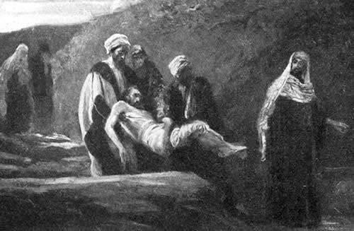
John 19.38-39: After this, Joseph of Arimathea, a disciple of Jesus (but secretly, because he feared the Jewish leaders), asked Pilate if he could remove the body of Jesus. Pilate gave him permission, so he went and took the body away. Nicodemus, the man who had previously come to Jesus at night, accompanied Joseph, carrying
a mixture of
myrrh and aloes
weighing about
seventy-five
pounds.

Slide 8
John 19.40-42: Then they took Jesus' body and wrapped it, with the aromatic spices, in strips of linen cloth according to Jewish burial customs. Now at the place where Jesus was crucified there was a garden, and in the garden was a new tomb where no one had yet been buried. And so, because it was the Jewish day of preparation and the tomb was nearby, they placed Jesus' body there.

Slide 10
Matthew 5.14-16 NET: You are the light of the world. A city located on a hill cannot be hidden. People do not light a lamp and put it under a basket but on a lampstand, and it gives light to all in the house. In the same way, let your light shine before people, so that they can see your good deeds and give honor to your Father in heaven.
You are the light of the world…
let your light shine…

